Slide 1

Heated Room
Gemaakt door: Erik Kooijman – GD2B

Slide 2
Heated Room
Inhoud
Game concept
Opbouw van de game
Platform
Live demonstratie

Slide 3
Heated Room
Het concept

Slide 4
Heated Room

Slide 5
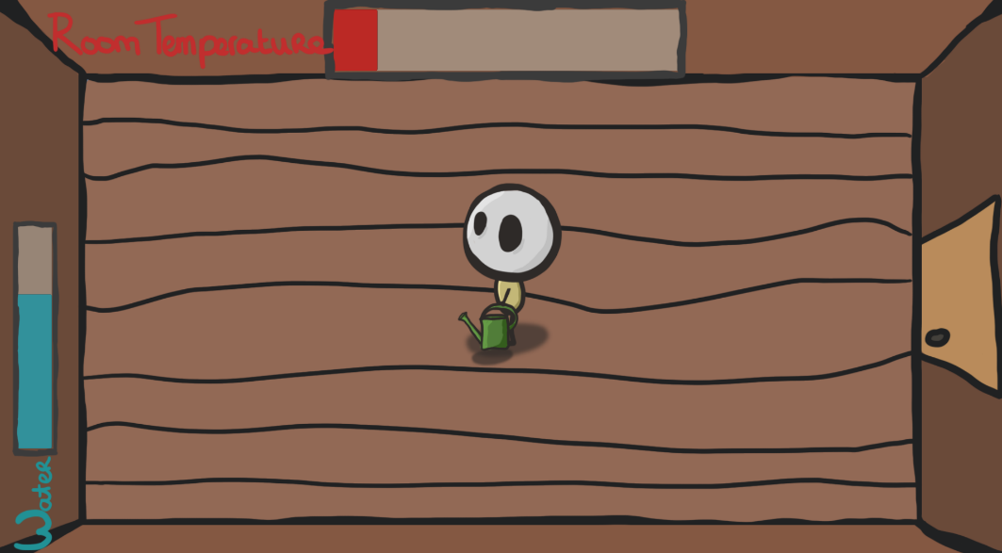
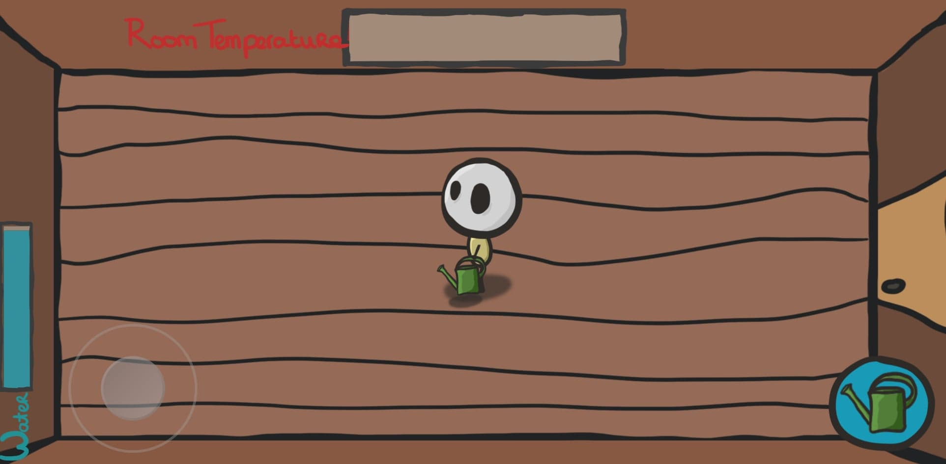
Heated Room
Platforms

Slide 6
Heated Room
Live demonstratie

Slide 7
Heated Room
Vragen??

